Slide 1
MAZES AND SHORTEST PATH ALGORITHMS
Shirel Attali
Algorithm developer
7/2017

Slide 2
AGENGDA
Mazes and shortest path
Breadth First Search algorithm
Dijkstra algorithm
Best first search algorithm
A* algorithm
Performance of A*
Summery

Slide 3
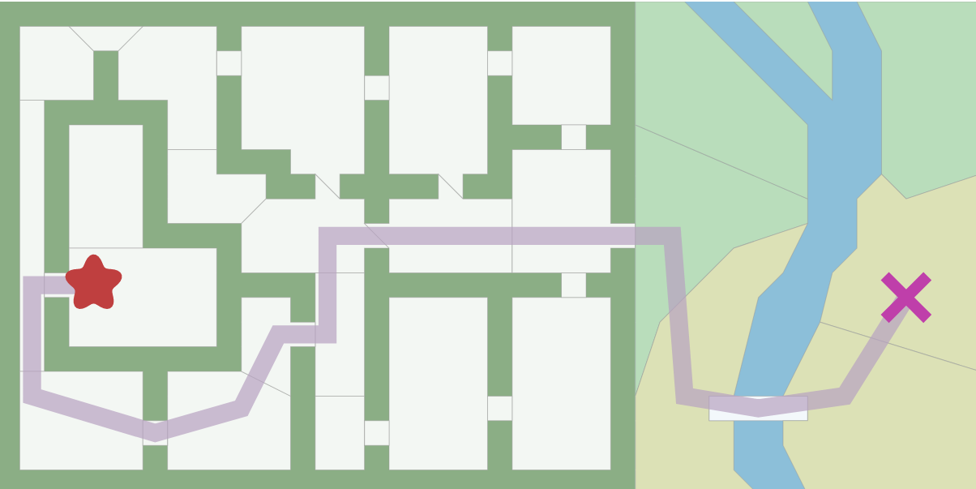
MAZES AND SHORTEST PATH
http://www.redblobgames.com/pathfinding/a-star/introduction.html

Slide 4
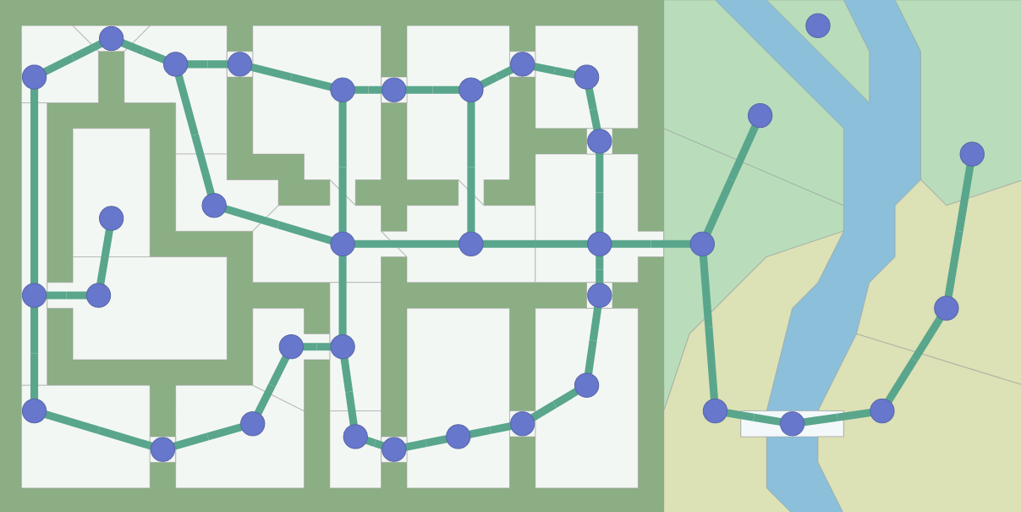
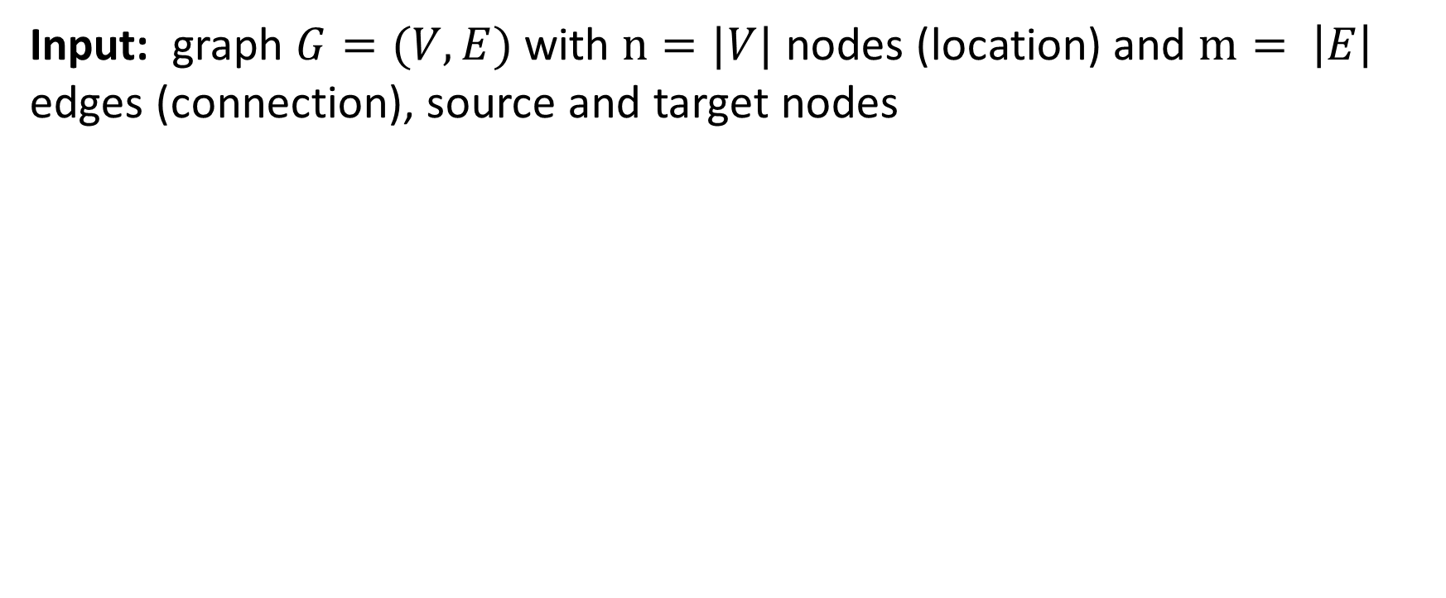
REPRESENTING THE MAP
Input: graph $G=(V,E)$ with $n=|V|$ nodes (location) and $m= \left|E\right|$ edges (connection), source and target nodes

Slide 5
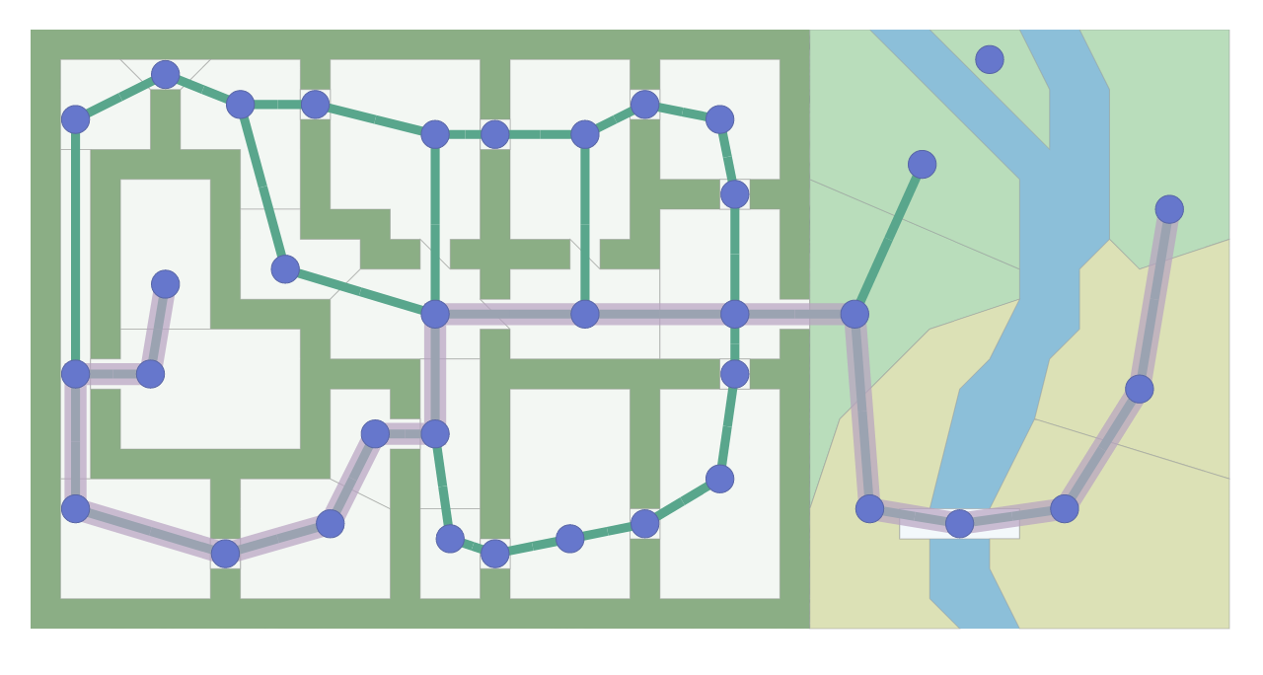
Output: The path found by the search algorithm is made of graph nodes and edges

Slide 6
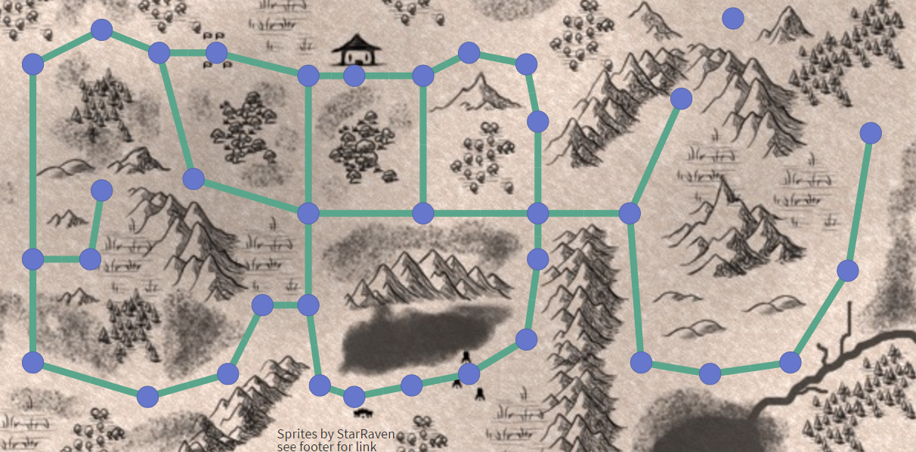
THE MATHEMATICAL APPROACH

Slide 7
THE HEURISTIC APPROACH

Slide 8
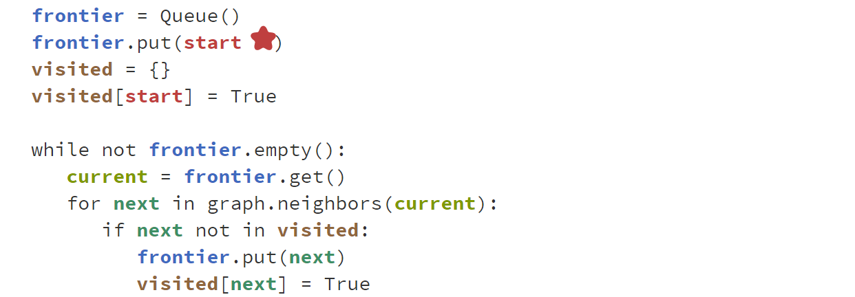

BREADTH FIRST SEARCH (BFS)
Running time: $O(\left|E\right|+\left|V\right|)$

Slide 9
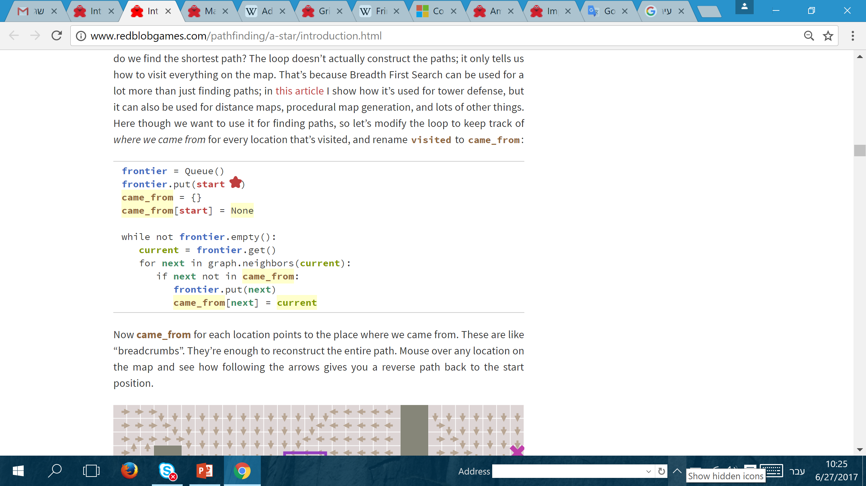
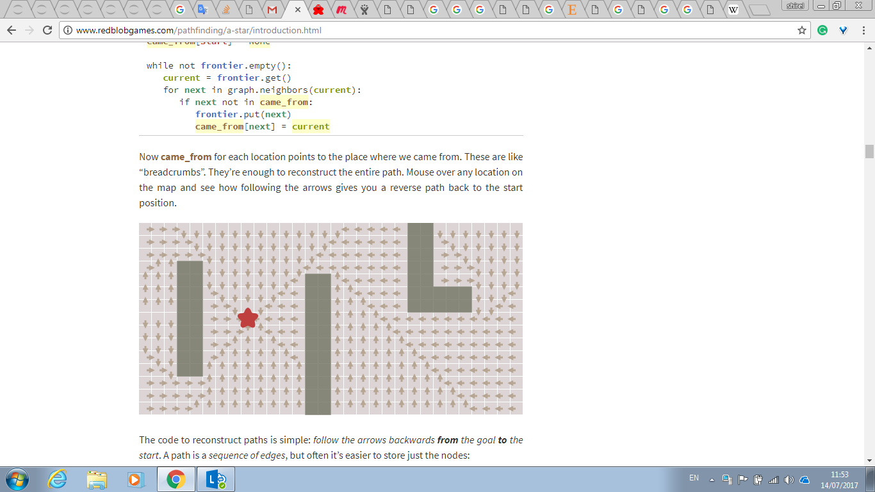
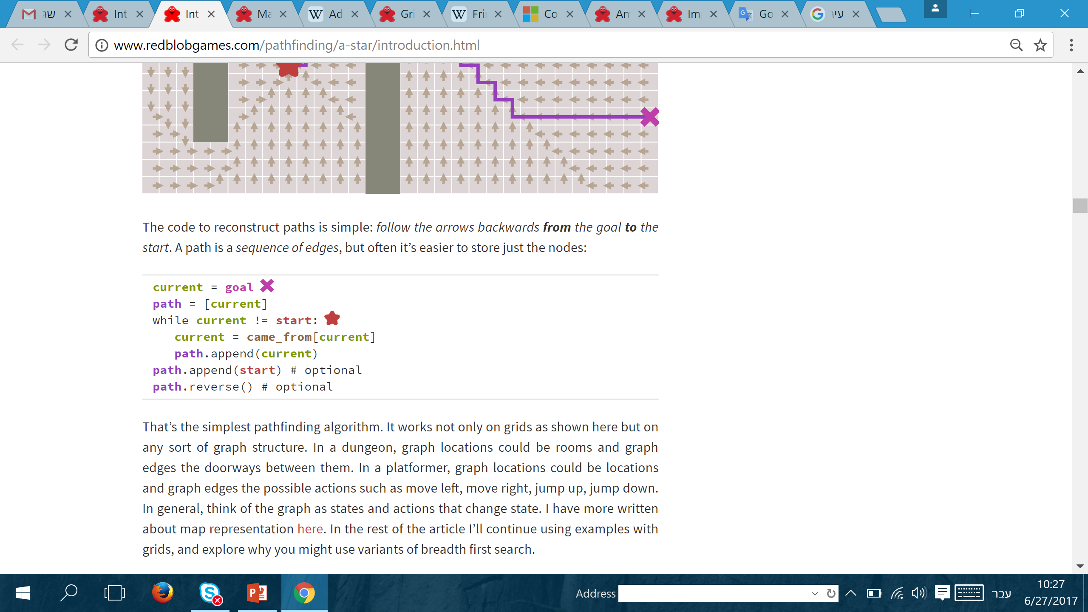
BREADTH FIRST SEARCH

Slide 10
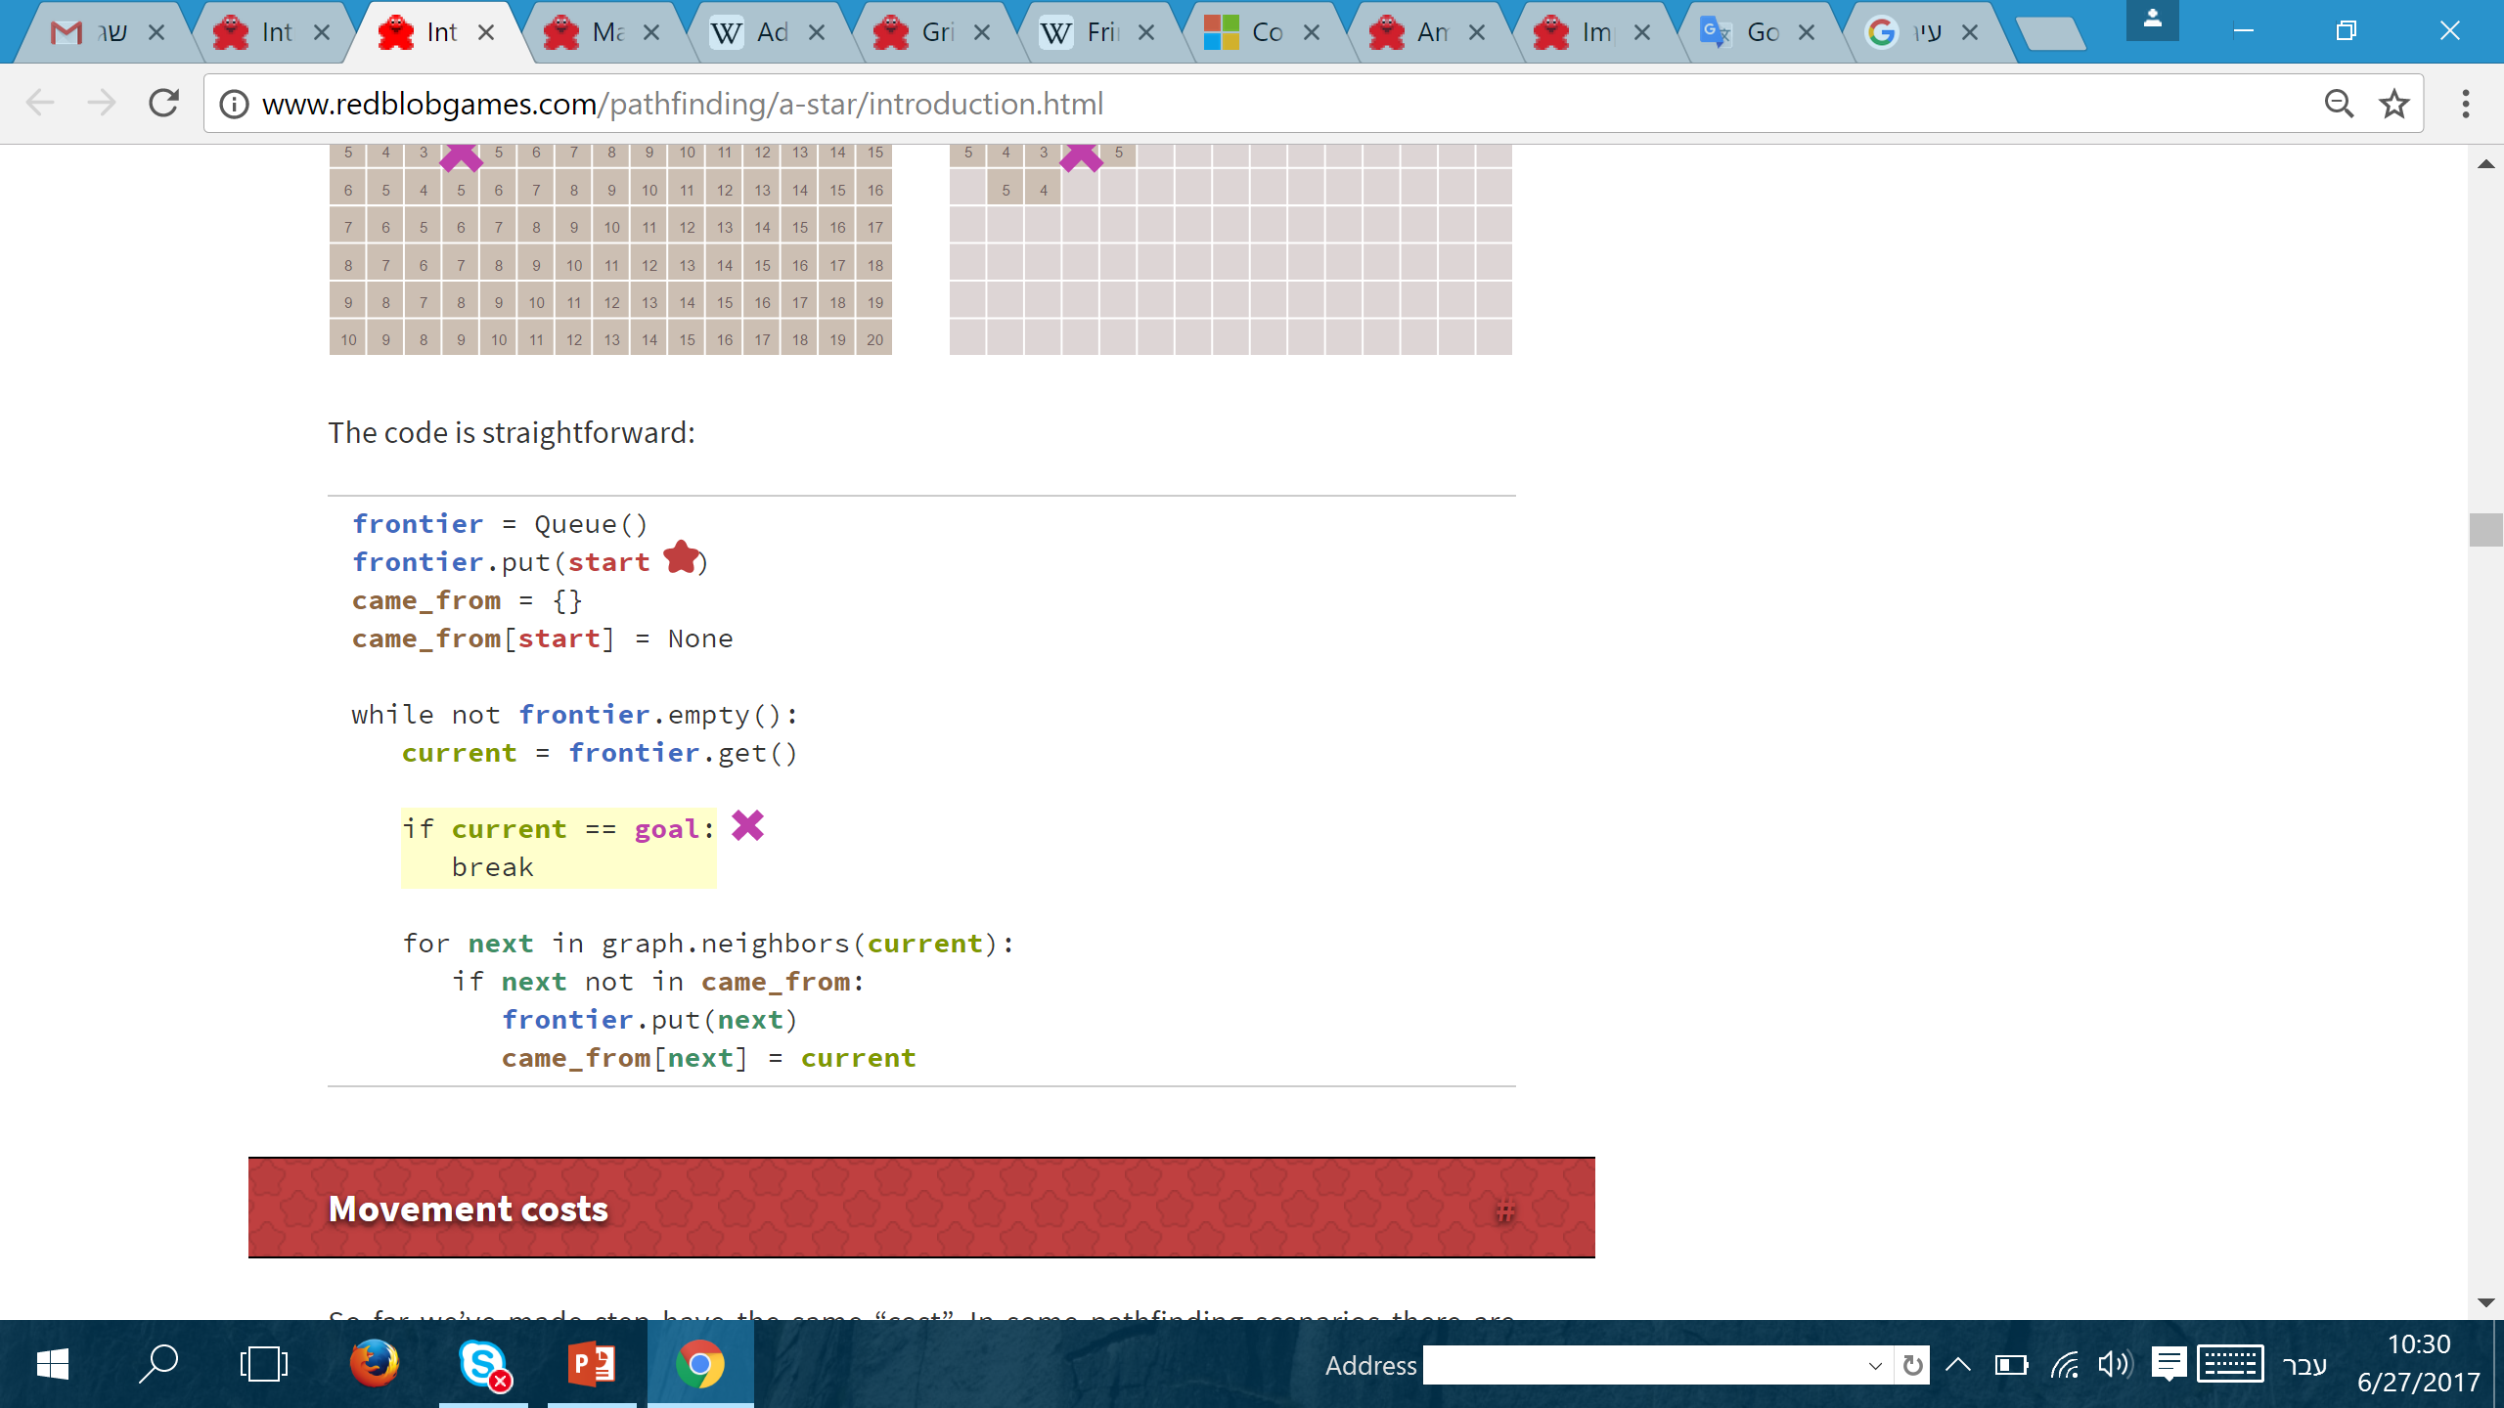
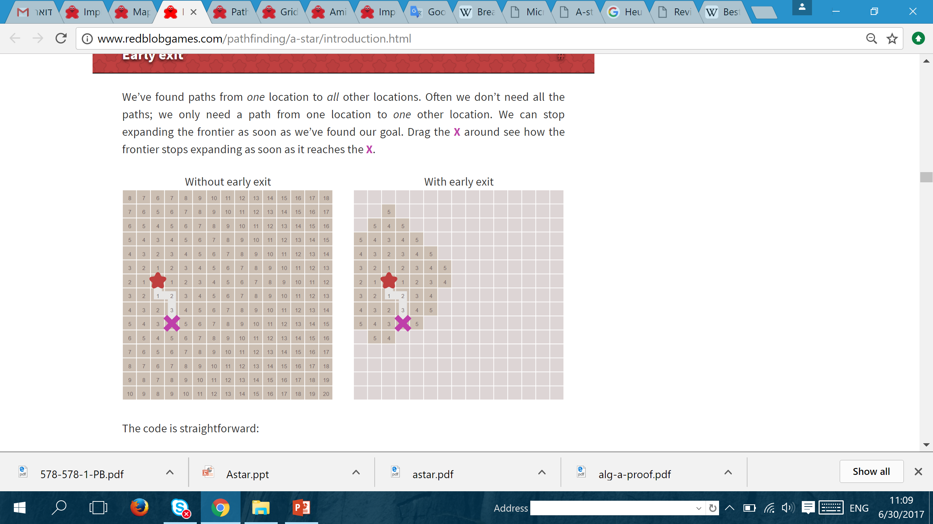
Early exit
Without early exit
With early exit

Slide 11
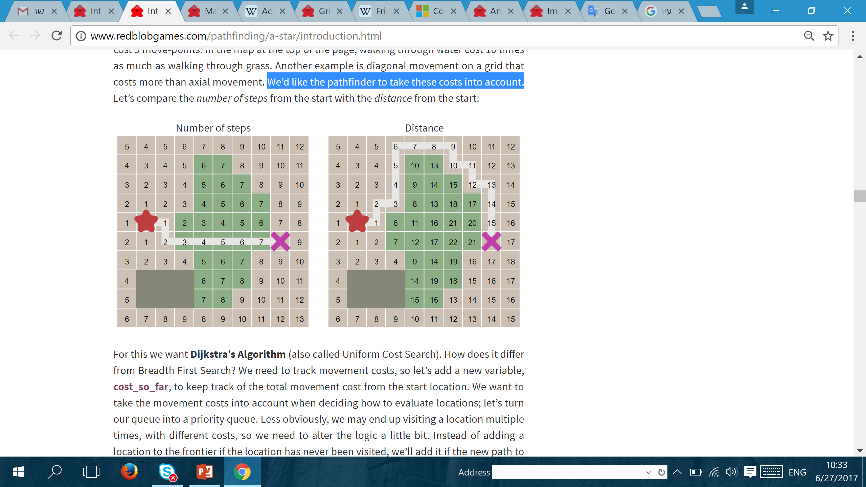
Movement costs
So far we’ve made step have the same “cost”.
In some pathfinding scenarios there are different costs for different types of movement.

Slide 12
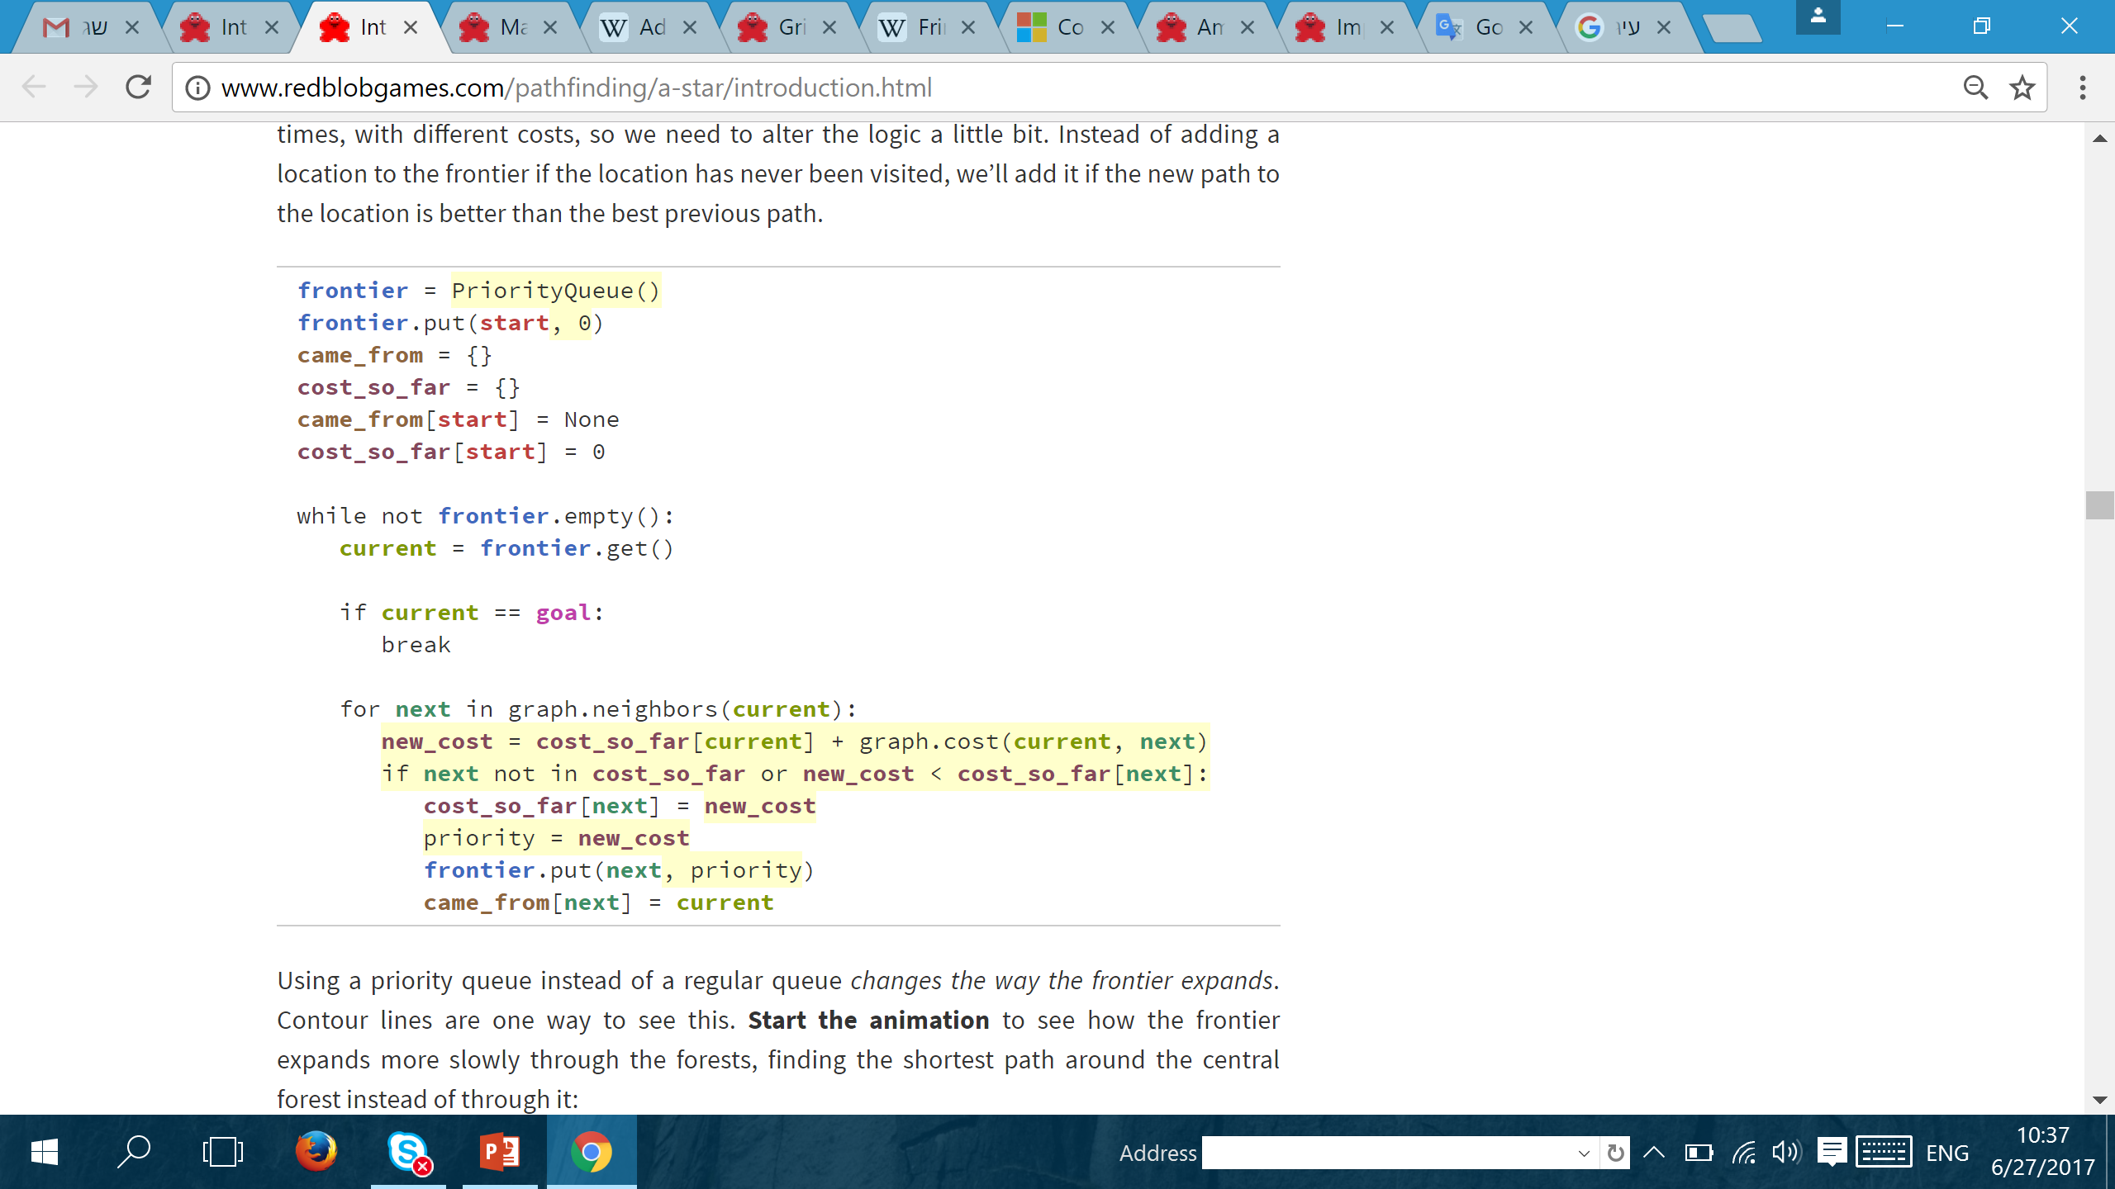
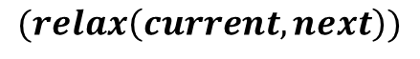
DIJKSTRA’S ALGORITHM
next
start
current
$cost_so_far$ $\left(current\right)+cost\left(current,next\right)<cost_so_far \left(next\right)$
$$(relax\left(current,next\right))$$

Slide 13
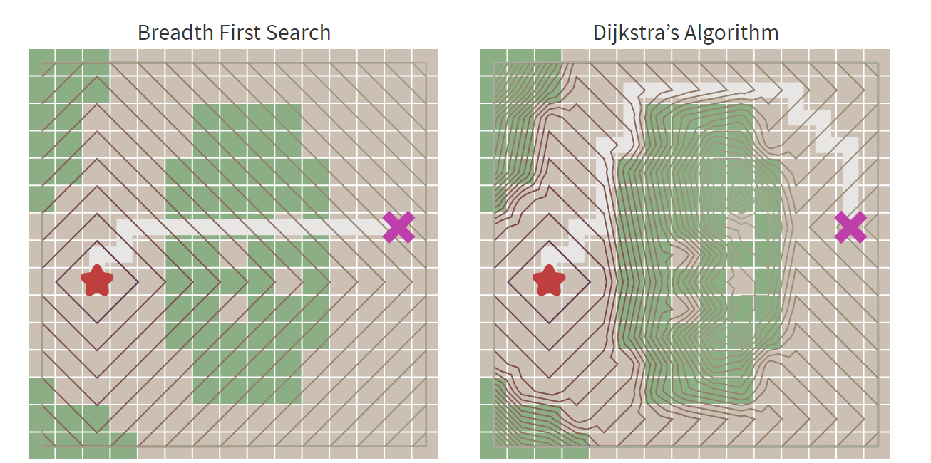
BFS vs DIJKSTRA

Slide 14
HEURISTIC SEARCH
With BFS and Dijkstra, the frontier expands in all directions
However, a common case is to find a path to only one location
Let’s make the frontier expand towards the goal more than it expands in other directions.

Slide 15
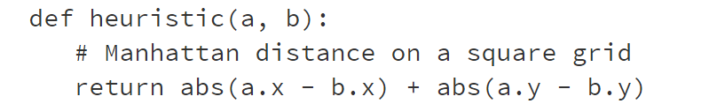
HEURISTIC FUNCTION
Estimates the distance between each node and the goal
Should be computationally easy
The implementation can vary depending on the properties of the graph

Slide 16

BEST FIRST SEARCH

Slide 17
DIJKSTRA vs BEST FIRST SEARCH

Slide 18
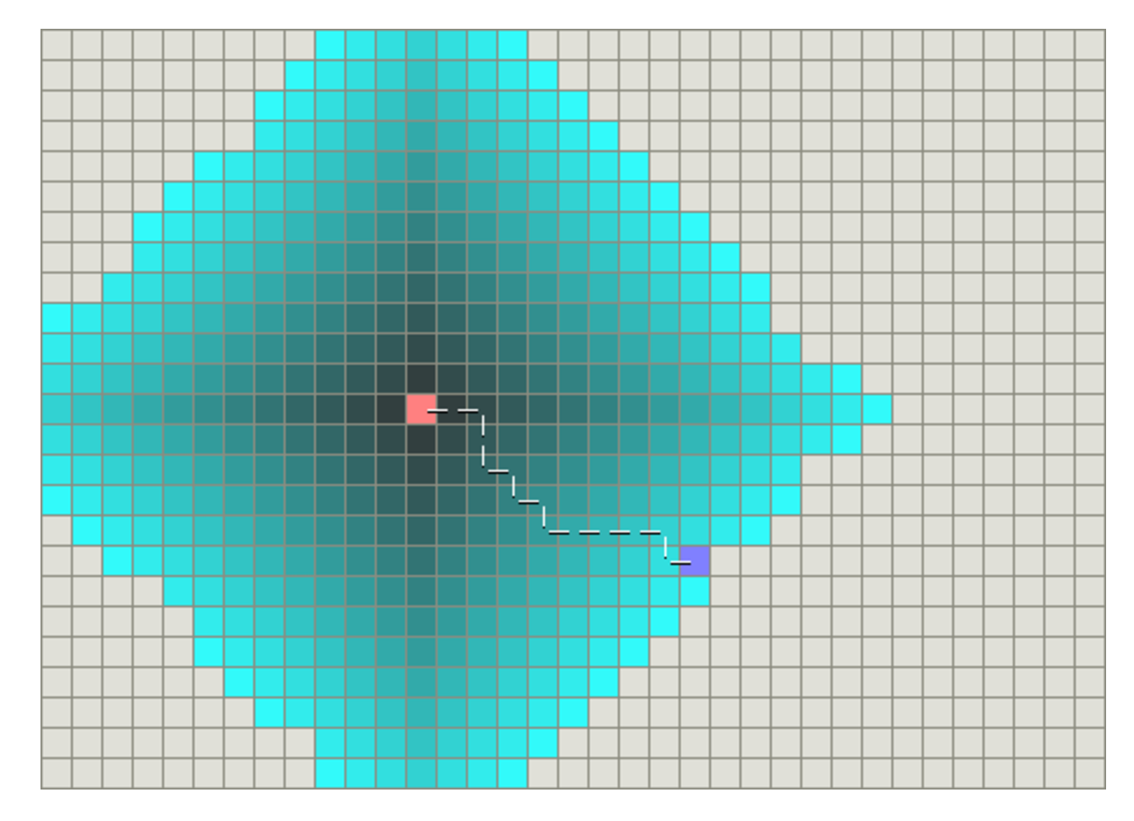
Dijkstra’s Algorithm
the pink square is the starting point, the blue square is the goal, and the teal areas show what areas Dijkstra’s algorithm scanned.

Slide 19
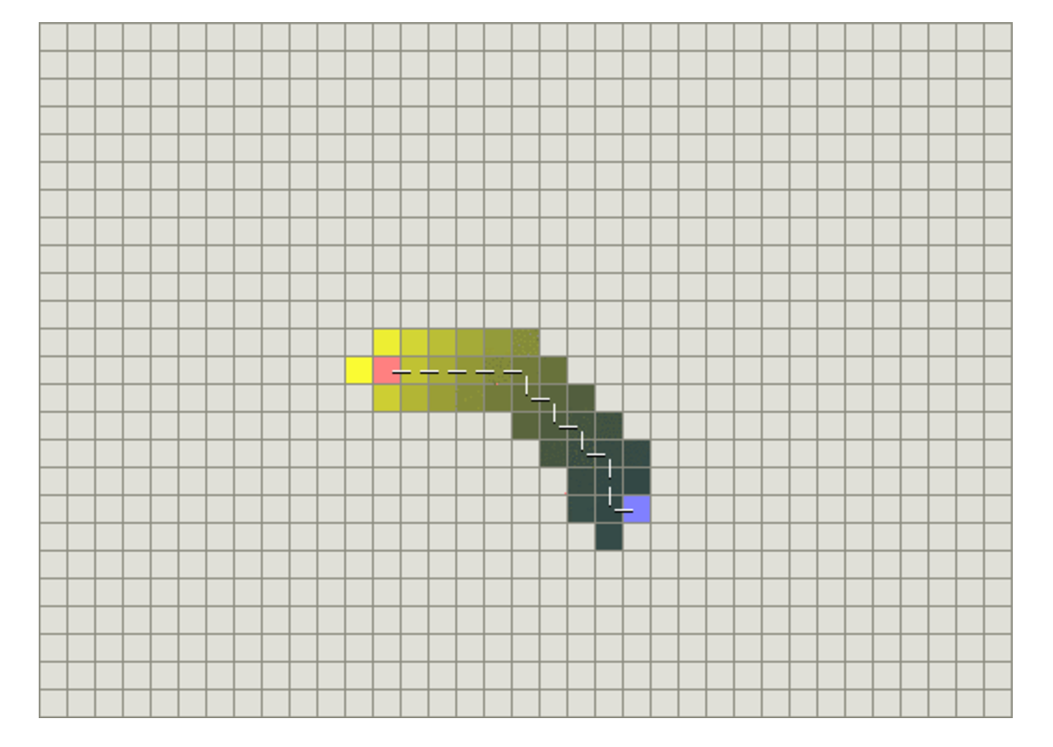
Best First Search
yellow represents those nodes with a high heuristic value (high cost to get to the goal) and black represents nodes with a low heuristic value (low cost to get to the goal).

Slide 20
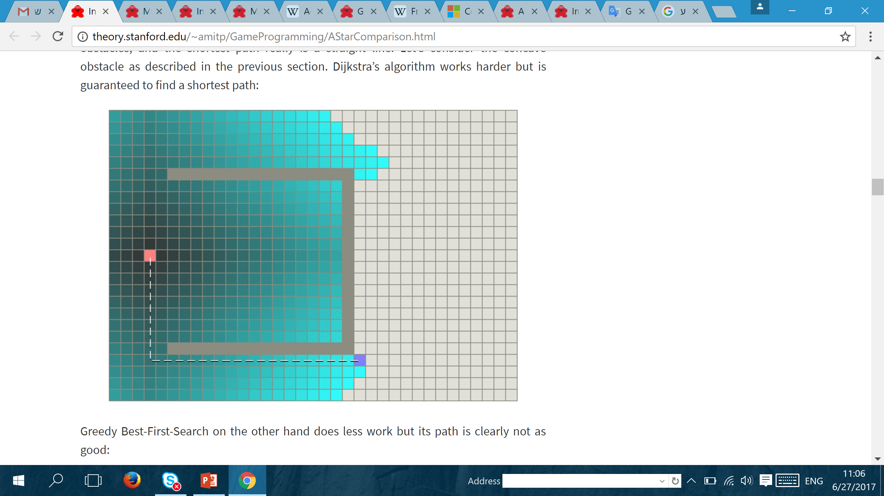
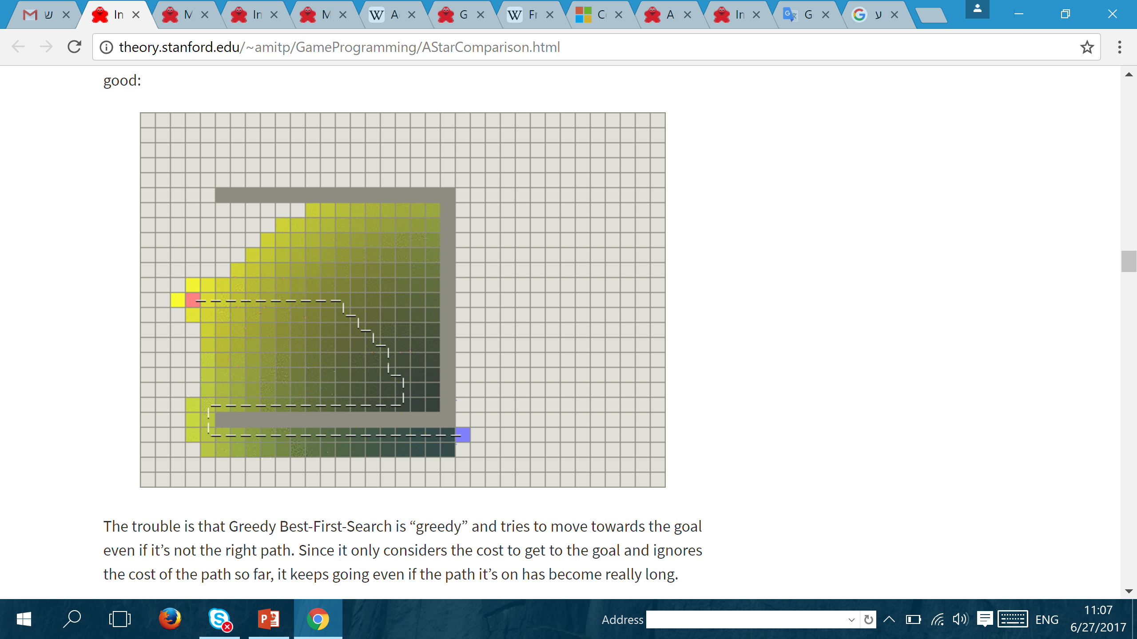
Dijkstra’s Algorithm
Best First Search

Slide 21
THE A* ALGORITHM – COMBINE THE BEST OF BOTH
Dijkstra’s Algorithm works well to find the shortest path, but it wastes time exploring in directions that aren’t promising.
(Greedy) Best First Search explores in promising directions but it may not find the shortest path.
The A* algorithm uses both the actual distance from the start and the estimated distance to the goal.

Slide 22
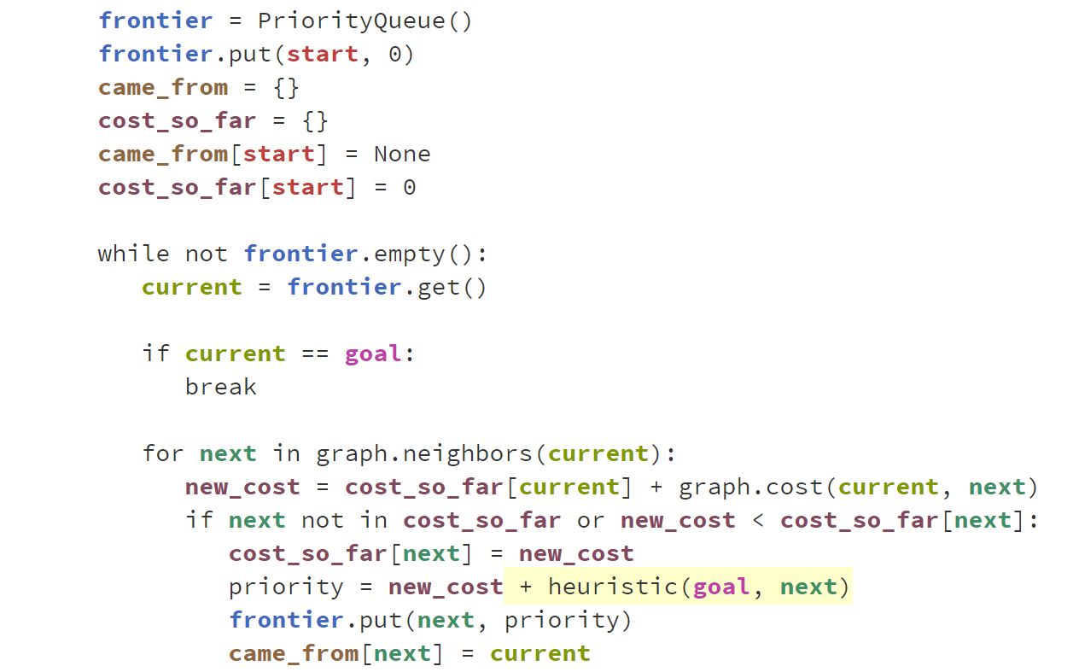
A* ALGORITHM
goal
next
start
current

Slide 23
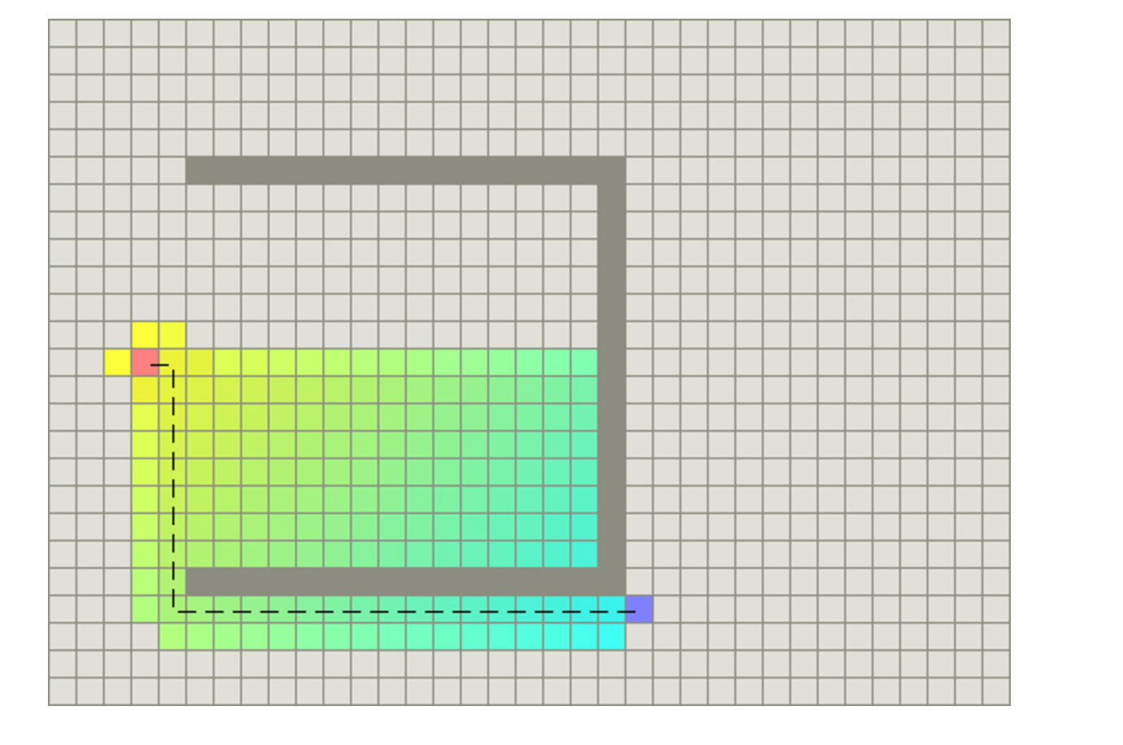
A* ALGORITHM

Slide 24
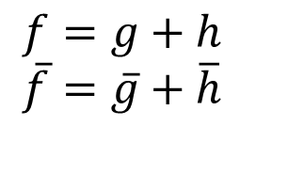
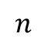
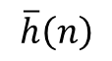
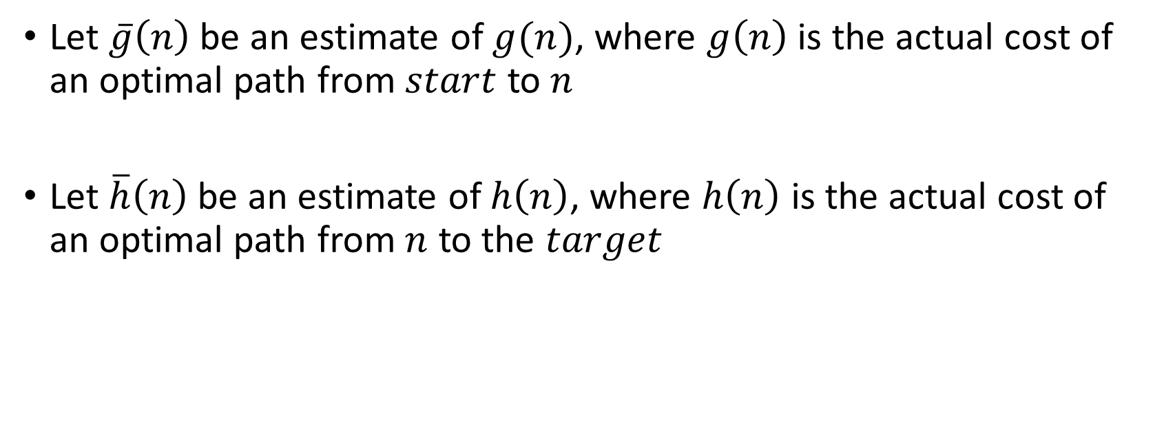
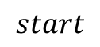
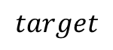
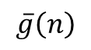
PERFORMANCE OF A*
Let $\overline{g}\left(n\right)$be an estimate of $g(n)$, where $g\left(n\right)$is the actual cost of an optimal path from $start$ to $n$
Let $\overline{h}\left(n\right)$be an estimate of $h\left(n\right)$, where $h\left(n\right)$ is the actual cost of an optimal path from $n$ to the $target$
$$n$$
$$target$$
$$f=g+h$$
$$\overline{f}=\overline{g}+\overline{h}$$
$$start$$
$$\overline{g}\left(n\right)$$
$$\overline{h}\left(n\right)$$

Slide 25
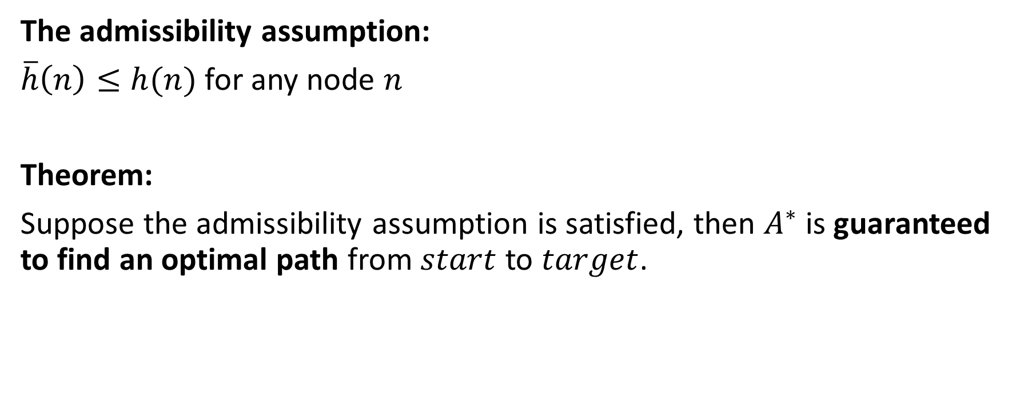
PERFORMANCE OF A*
The admissibility assumption:
$\overline{h}\left(n\right)≤h(n)$ for any node $n$
Theorem:
Suppose the admissibility assumption is satisfied, then $A^{∗}$ is guaranteed to find an optimal path from $start$ to $target$.

Slide 26
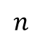
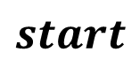
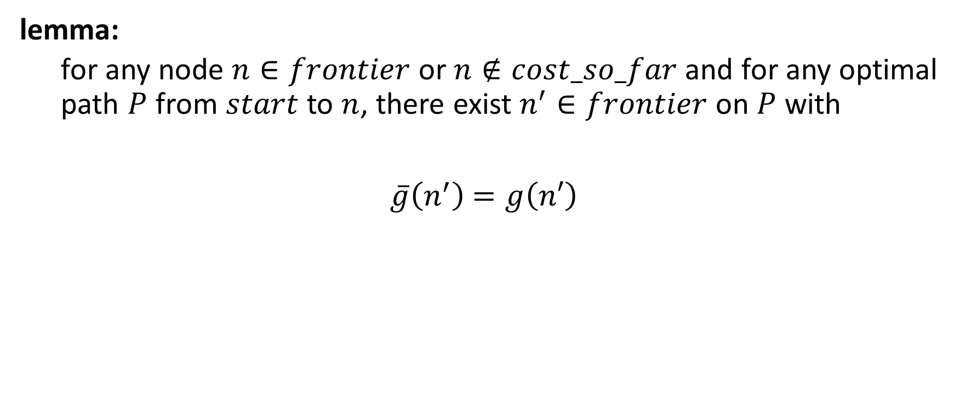
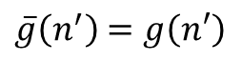
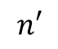

PROOF
lemma:
for any node $n∈frontier$ or $n∉cost_so_far$ and for any optimal path $P$ from $start$ to $n$, there exist $n^{′}∈frontier$on $P$ with
$\overline{g}\left(n^{′}\right)$ $=g\left(n′\right)$
$$P$$
$$n′$$
$$n$$
$\overline{g}\left(n^{′}\right)$ $=g\left(n′\right)$
$$start$$

Slide 27
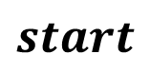
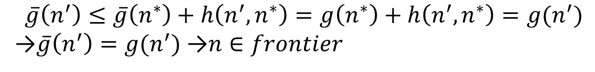
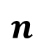
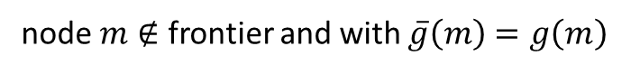
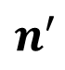
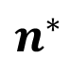

PROOF
$$n$$
Proof of lemma:
$$P^{∗}$$
node $m∉$ frontier and with $\overline{g}\left(m\right)$ $=g\left(m\right)$
$$n^{′}$$
$$n^{∗}$$
$$start$$
$$\overline{g}\left(n^{′}\right)≤\overline{g}\left(n^{∗}\right)+h\left(n^{′},n^{∗}\right)=g\left(n^{∗}\right)+h\left(n^{′},n^{∗}\right)=g(n^{′})$$
→$\overline{g}\left(n^{′}\right)=g(n^{′})$ →$n∈frontier$

Slide 28
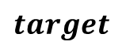
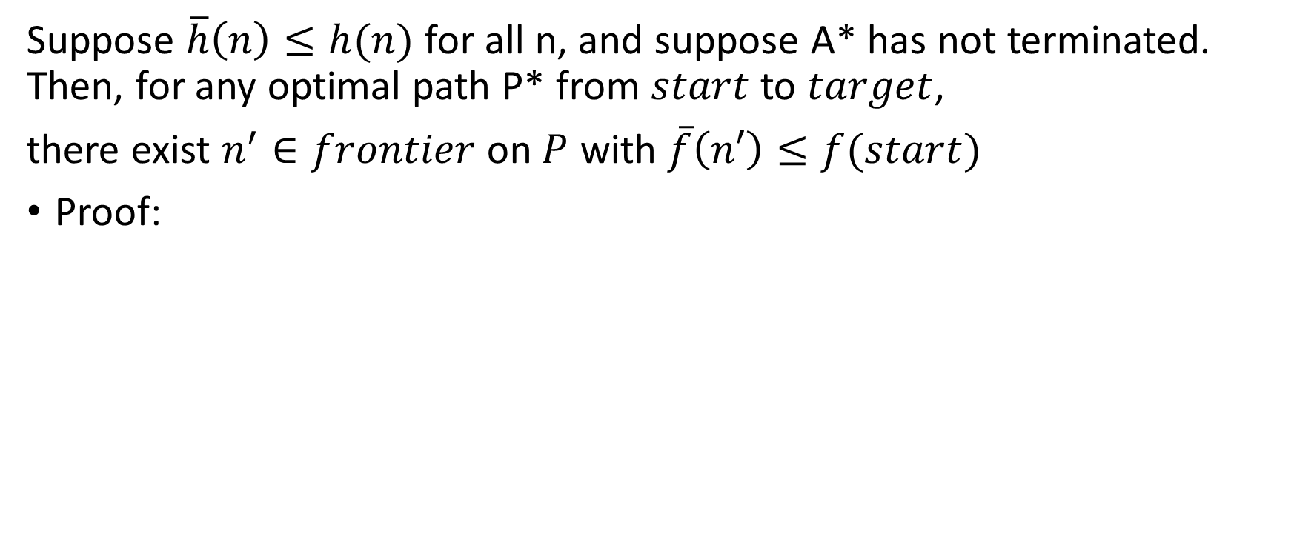
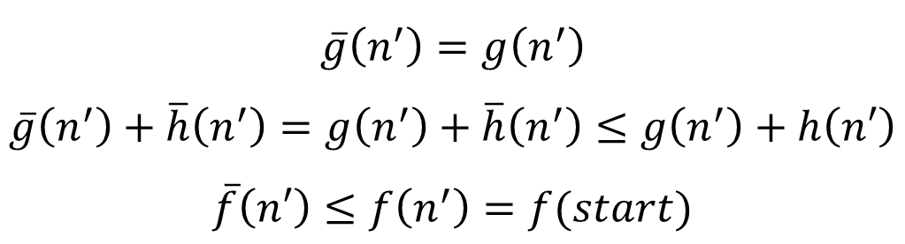
CORROLARY
Suppose $\overline{h}\left(n\right)≤h(n)$ for all n, and suppose A* has not terminated. Then, for any optimal path P* from $start$ to $target$,
there exist $n^{′}∈frontier$on $P$ with $\overline{f}\left(n′\right)≤f(start)$
Proof:
$$target$$
$$P^{∗}$$
$$n^{′}$$
$$n^{∗}$$
$$\overline{g}\left(n^{′}\right)=g\left(n^{′}\right)$$
$$\overline{g}\left(n^{′}\right)+\overline{h}\left(n^{′}\right)=g\left(n^{′}\right)+\overline{h}\left(n^{′}\right)≤g\left(n^{′}\right)+h\left(n′\right)$$
$$\overline{f}\left(n′\right)≤f\left(n^{′}\right)=f(start)$$
$$start$$

Slide 29
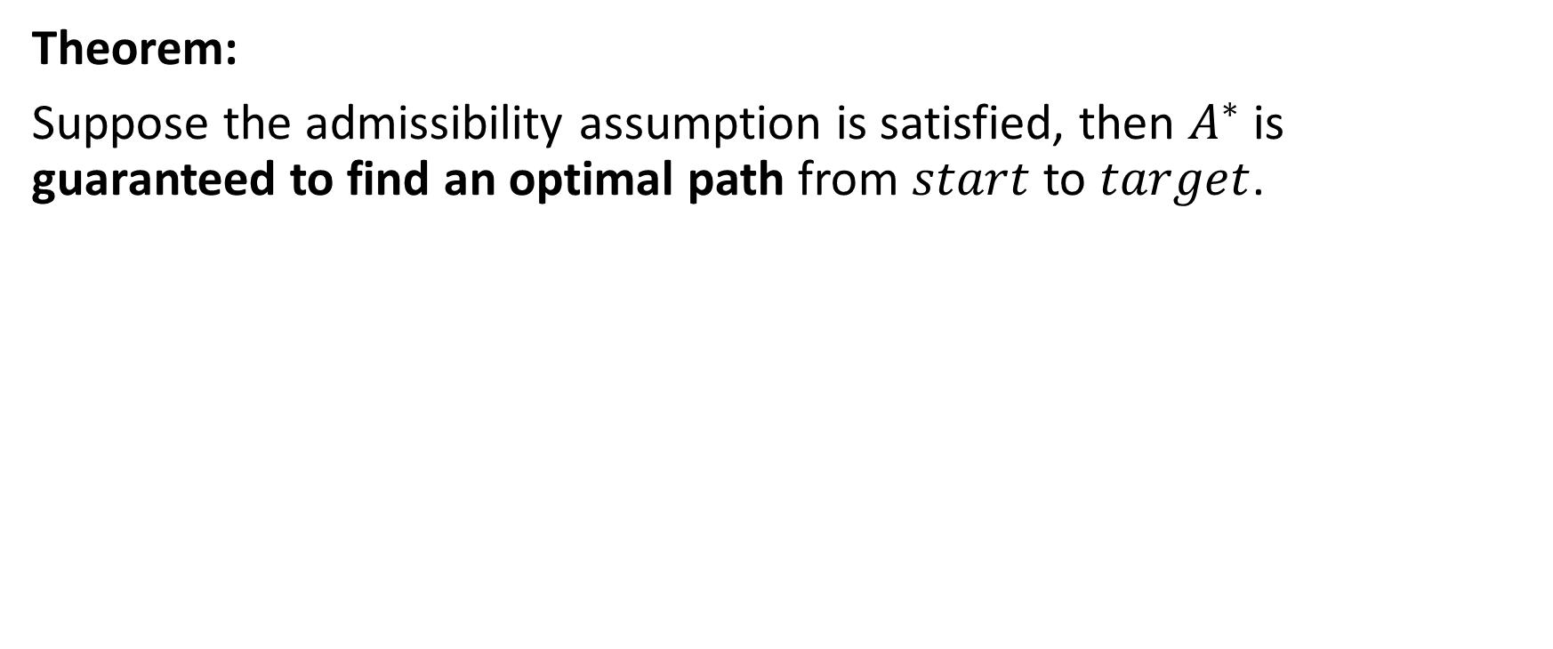
PERFORMANCE OF A*
Theorem:
Suppose the admissibility assumption is satisfied, then $A^{∗}$ is guaranteed to find an optimal path from $start$ to $target$.

Slide 30
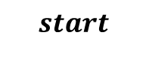
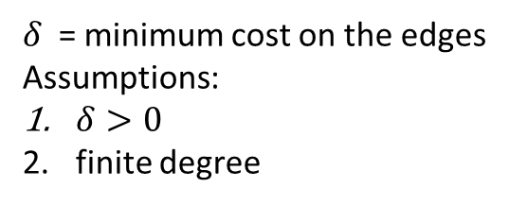
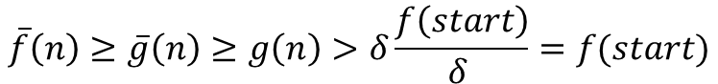
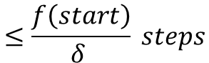
There is no termination
$δ$ = minimum cost on the edges
Assumptions:
$δ>0$
finite degree
$$\overline{f}\left(n\right)≥\overline{g}\left(n\right)≥g\left(n\right)>δ\frac{f\left(start\right)}{δ }=f(start)$$
$$start$$
$$≤\frac{f\left(start\right)}{δ } steps$$
(there exist $n^{′}∈frontier$on $P$ with $\overline{f}\left(n′\right)≤f(start)$ → $\overline{f}\left(n′\right)<\overline{f}(n)\text{→}$no nodes outside the cycle can be expanded)

Slide 31
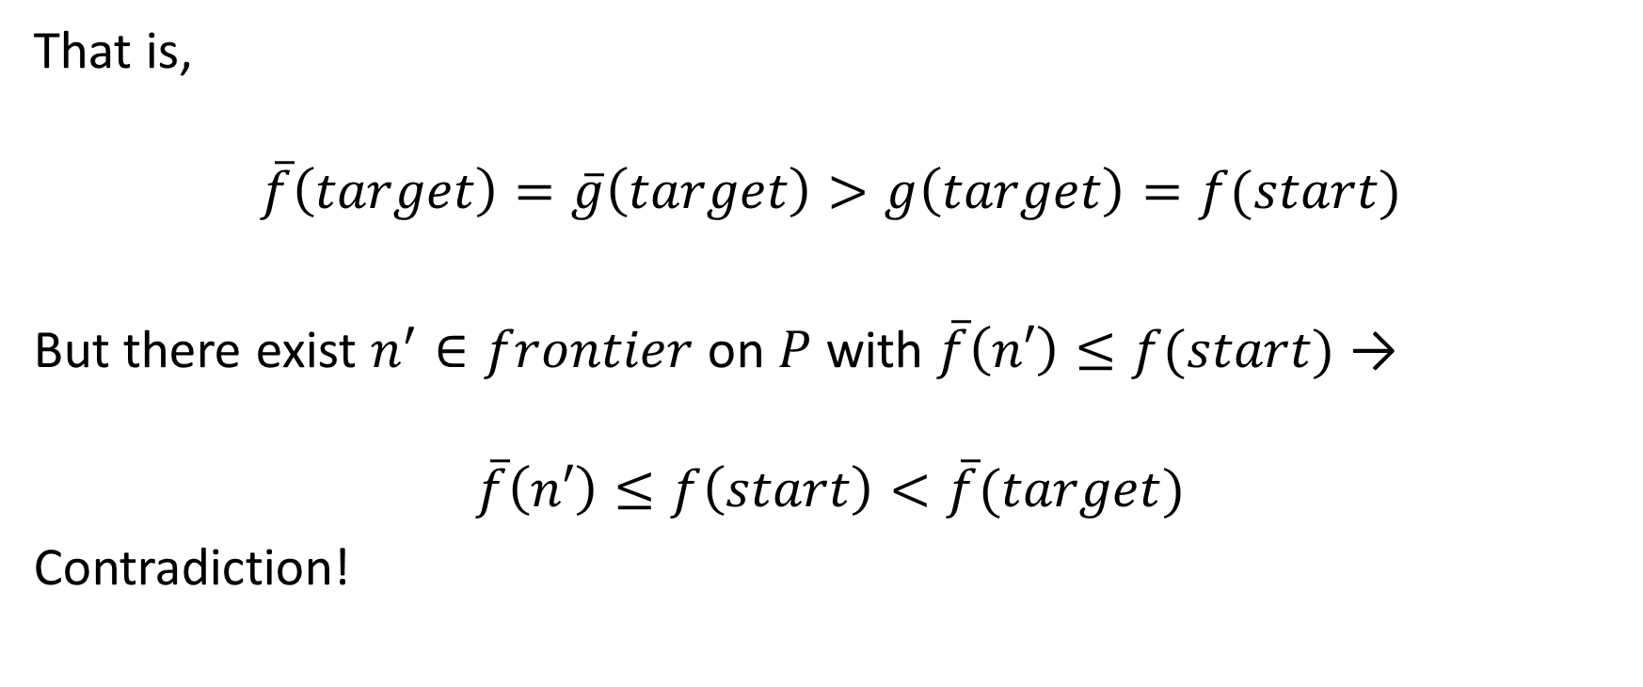
Terminate at target without achieving minimum cost
That is,
$$\overline{f}\left(target\right)=\overline{g}\left(target\right)>g\left(target\right)=f(start)$$
But there exist $n^{′}∈frontier$on $P$ with $\overline{f}\left(n′\right)≤f(start)$ →
$$\overline{f}\left(n′\right)≤f\left(start\right)<\overline{f}(target)$$
Contradiction!

Slide 32

PERFORMANCE OF A*
The consistency assumption:
$\overline{h}\left(n\right)≤\overline{h}\left(m\right)+h(n,m)$ for any nodes $m$ and $n$
Theorem:
suppose the consistency assumption is satisfied, and suppose that we got out node $n$ of the frontier. Then
$\overline{g}\left(n\right)$ $=g\left(n\right)$

Slide 33


RUNNING TIME
Corollary:
consistency assumption → Time = $Ο\left(\left|E\right|⋅\left|T_{dk}\right|+\left|V\right|⋅\left|T_{em}\right|\right)$
$T_{dk}$ - complexities of the decrease-key operation
$T_{em}$ - complexities of the extract-minimum operation
$$Ο\left(\left|E\right|+\left|V\right|⋅\log{|V|}\right)$$

Slide 34


PERFORMANCE OF A*
Let N be the number of nodes to the solution path
Best performance: $O\left(N\right)$
Worst case: $O(b^{N})$ where $b$ is the branching factor.
$$\left|\overline{h}\left(N\right)−h\left(n\right)\right|≤err\left(N\right)$$
$$number of nodes to be explored$$

Slide 35

Gasching(1979):
If $err\left(N\right)=c$, then the worst case time complexity of A* is $O(N)$
If $err\left(N\right)=clog(N)$, then the worst case time complexity of A* is $O(N^{k})$
If $err\left(N\right)=cN$, then the worst case time complexity of A* is exponential in the length of the solution path.

Slide 36

PERFORMANCE OF A*
Theorem:
If an admissible algorithm $A$ is no more informed than $A^{∗}$, and suppose the consistency assumption is satisfied by $A^{∗}.$
Then any node expanded by $A^{∗}$must also be expanded by $A$

Slide 37




SUMMERY
Dijkstra’s Algorithm
Best First Search
A* Algorithm
$$\overline{h}≡0$$
$$\overline{h}≤h$$
$$\overline{h}≥h$$
$$Time$$

Slide 38

SUMMERY
BFS and Dijkstra → find the shortest path.
Best First Search → NOT guaranteed to find the shortest path
A* → guaranteed to find the shortest path if $\overline{h}\left(n\right)≤h\left(n\right)$

Slide 39
SUMMERY
finding paths from or to all locations → BFS or Dijkstra
movement costs are all the same → BFS
movement costs vary → Dijkstra
finding path to one location → Best First Search or A*.
Prefer A* in most cases

Slide 40
SUMMERY
Best First Search typically runs faster than Dijkstra’s Algorithm but doesn’t produce optimal paths
A* is a good choice for most pathfinding needs!

Slide 41
THANKS!
Shirel Attali
Algorithm developer
attalishirel@gmail.com
7/2017

